Slide 1
Unit Testing

Slide 2
Test behaviour, not implementation
Tests that assert on behaviour are less brittle than tests that assert on the specific implementation. Whenever we verify a call on a mock we are breaking encapsulation and testing the internal workings of a class. It becomes impossible to change the implementation detail in a way that maintains the class behaviour.

Slide 3
Use contra-variant tests
https://blog.cleancoder.com/uncle-bob/2017/10/03/TestContravariance.html
There is a tendency to couple a production class to a unit test class, and when we do that the refactoring actions we can take become limited. Since refactoring should not break existing tests, if we need to adjust tests we aren't really refactoring - we're reworking. During that rework we can make unintentional changes to the tests that introduces additional risk. Testing behaviour instead of implementation assists in the creation of contra-variant tests.

Slide 4
Favour test quality over code coverage
Code coverage by itself is an easily gamed metric and doesn't reveal much about the production code quality or the quality of the tests. If we can add new features to existing code quickly and without much risk, then that code has a reasonable level of internal code quality. If we can refactor code to make improvements without breaking tests and still have confidence that the code behaves the same, then the test quality is also at a reasonable level.

Slide 5
Isolate your business logic from its application services and infrastructure
Code that's tightly coupled is hard to test, and code that leaks abstractions across layers is hard to test well. Design solutions following SOLID principles to create more testable code. Avoid leaking abstractions across layers to keep the core business logic separate from the supporting and hosting infrastructure.

Slide 6
Naming your tests
The name of your test should consist of three parts:
The name of the method being tested.
The scenario under which it's being tested.
The expected behavior when the scenario is invoked.
Why?
Naming standards are important because they explicitly express the intent of the test. => Tests are more than just making sure your code works, they also provide documentation. Just by looking at the suite of unit tests, you should be able to infer the behavior of your code without even looking at the code itself. Additionally, when tests fail, you can see exactly which scenarios do not meet your expectations.

Slide 7
Characteristics of a good unit test
Fast. It is not uncommon for mature projects to have thousands of unit tests. Unit tests should take very little time to run. Milliseconds.
Isolated. Unit tests are standalone, can be run in isolation, and have no dependencies on any outside factors such as a file system or database.
Repeatable. Running a unit test should be consistent with its results, that is, it always returns the same result if you do not change anything in between runs.
Self-Checking. The test should be able to automatically detect if it passed or failed without any human interaction.
Timely. A unit test should not take a disproportionately long time to write compared to the code being tested. If you find testing the code taking a large amount of time compared to writing the code, consider a design that is more testable.

Slide 8
Avoid logic in tests
When writing your unit tests avoid manual string concatenation and logical conditions such as if, while, for, switch, etc.
Why?
Less chance to introduce a bug inside of your tests.
Focus on the end result, rather than implementation details.
When you introduce logic into your test suite, the chance of introducing a bug into it increases dramatically. The last place that you want to find a bug is within your test suite. You should have a high level of confidence that your tests work, otherwise, you will not trust them. Tests that you do not trust, do not provide any value. When a test fails, you want to have a sense that something is actually wrong with your code and that it cannot be ignored.

Slide 9
When to create function for arrange?
When arrange data creation is quite big.
When we unable to understand whats going on in arrage part.

Slide 10
Questions:
When to test and not to test method?
How to test private method?
Can I test static class?
Shall we reuse solver functionality to build object or copy code from solver to test and build object?

Slide 11
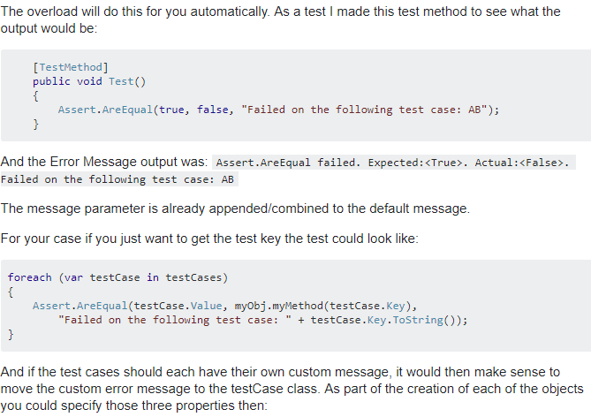

Slide 12
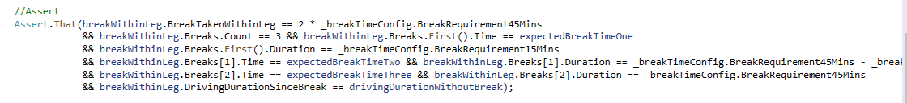
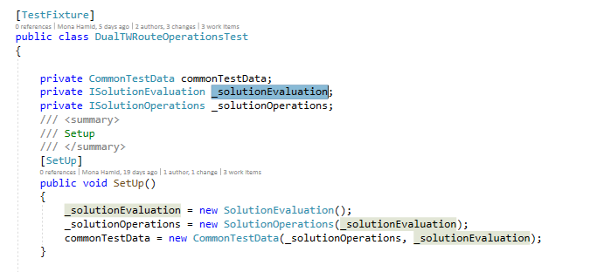

Slide 13
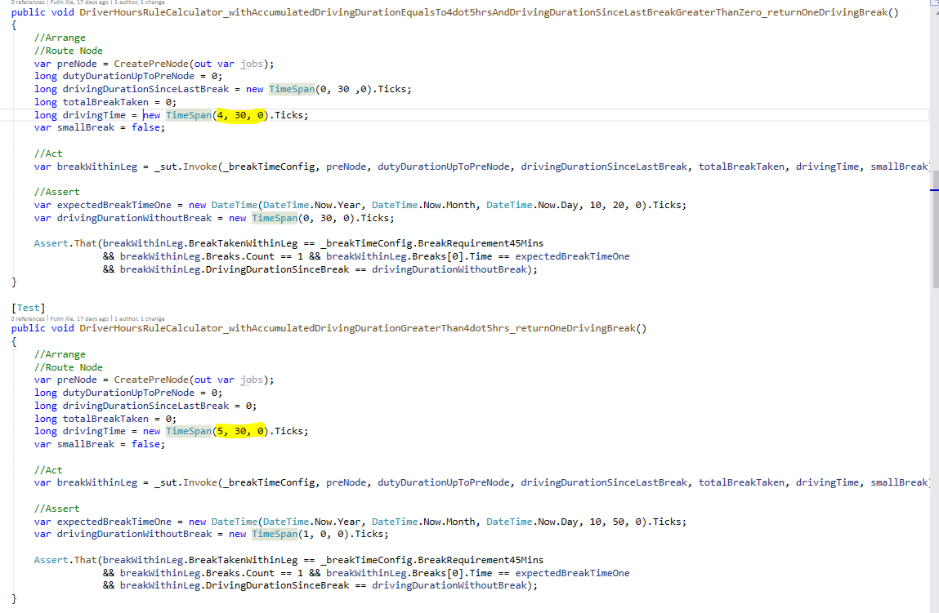

Slide 14
Is it possible to get more break if driver is working for 12 hours? So that we will cover edge cases. (DriverHoursRuleCalculatorTest)

